Slide 1
Wireshark Lab

Slide 2
Wireshark Lab
Materials needed
Kali Linux Virtual Machine
Windows 7 Virtual Machine
Software Tools used (From Kali Linux OS)
Wireshark (TCP/IP Packet Analyzer)

Slide 3
Objectives Covered
Security+ Objectives (SY0-601)
Objective 4.1 - Given a scenario, use the appropriate tool to assess organizational security.
Packet capture and replay
Wireshark

Slide 4
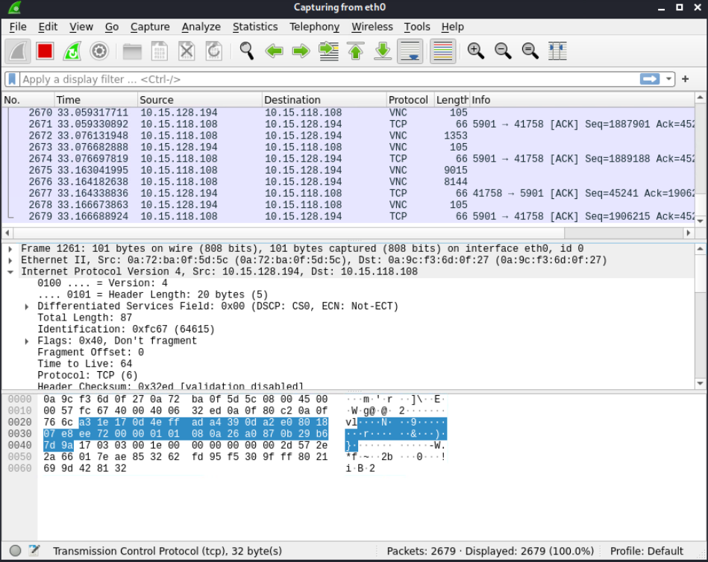
What is Wireshark?
Wireshark is a network protocol analyzer
Program that captures network traffic
Can capture packets from wired or wireless networks
Uses pcap to capture the packets
Captures details from packets
Sender/Receiver IP Addresses
Type of packet
Protocol used
Packet contents
Much, much more
Notes:
Bank: Chase
Username: jsmith17 Password: @pp13s33d

Slide 5
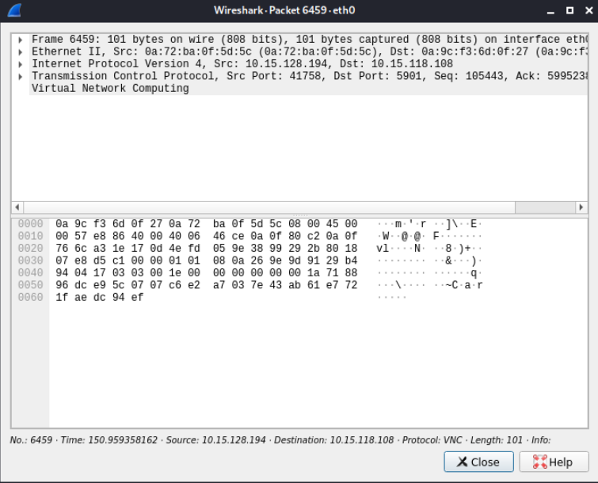
The Wireshark Lab
Setup Environments
Open Wireshark
Find Network Interface
Capture Packets
Analyze a Packet
Follow TCP Stream
Seeing a Capture

Slide 6
Setup Environments
Log into your range
Open the Kali Linux and Windows 7 Environments
You should be on your Kali Linux Desktop
You should also be on your Windows 7 Desktop

Slide 7
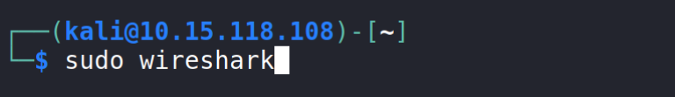
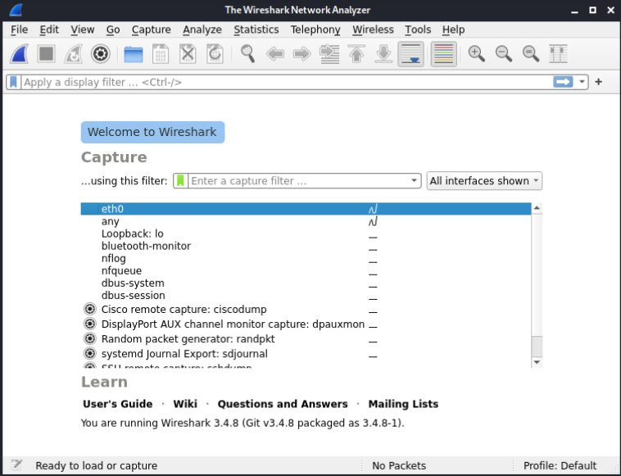
Open Wireshark
In Kali, open Terminal
Use the following command to open* the Wireshark application
sudo wireshark
You should see Wireshark open
*Use the following command if Wireshark is not installed:
sudo apt-get install wireshark -y

Slide 8
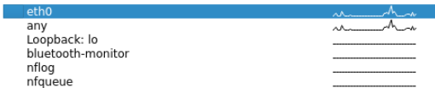
Find Network Interface
Lots of network traffic
Open a web browser
Navigate to a couple of websites
You should start to see Wireshark show some changes
Notice which interface is showing more traffic while you are loading webpages

Slide 9
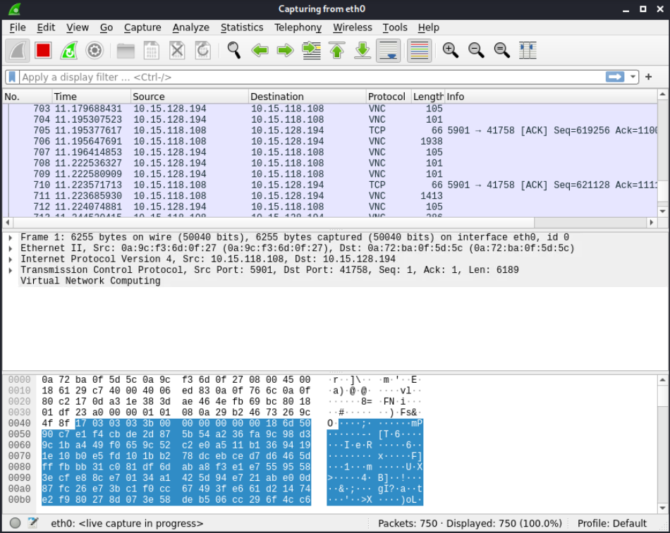
Capture Packets
Starts Capture
Stops Capture
Select the active network
Click the blue fin (top left) to start
Visit a website in the browser
Go back to Wireshark
Click the Red box to stop capturing

Slide 10
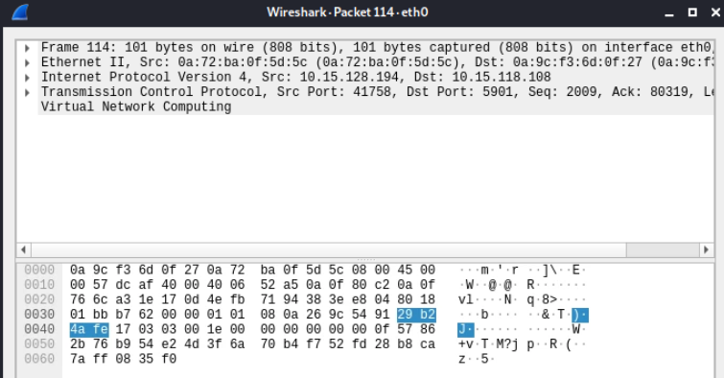
Analyze a Packet
Double click on a packet
This will display the contents of the packet
Find the following:
Length of the packet
Sender's and receiver's IP addresses
Protocol used
Source’s MAC Address
Destination’s MAC Address
Anything else?
Sample Packet

Slide 11
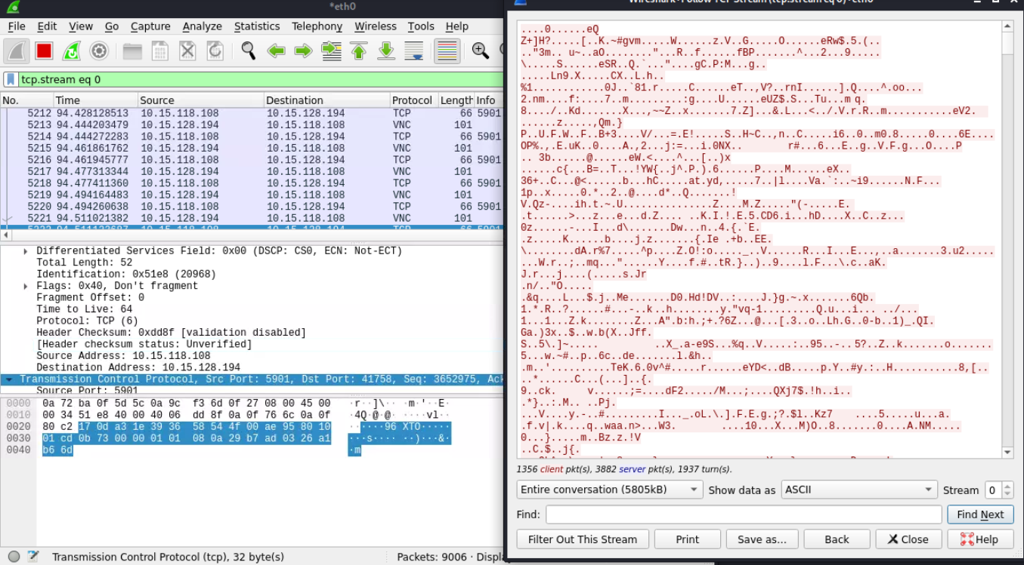
Follow TCP Stream
Find a Packet
Find a TCP Protocol packet if possible
Right-Click on the packet
Go to the “follow” option
Select the “TCP Stream” option
The window shows all the data from this stream
Stream = multiple packets that makeup an exchange of data
The main Wireshark window is displaying all the packets in this stream
What are you seeing?
This is a webserver communicating with a browser
Each website you visit carries out a similar exchange
All the packets
All the packet’s data

Slide 12
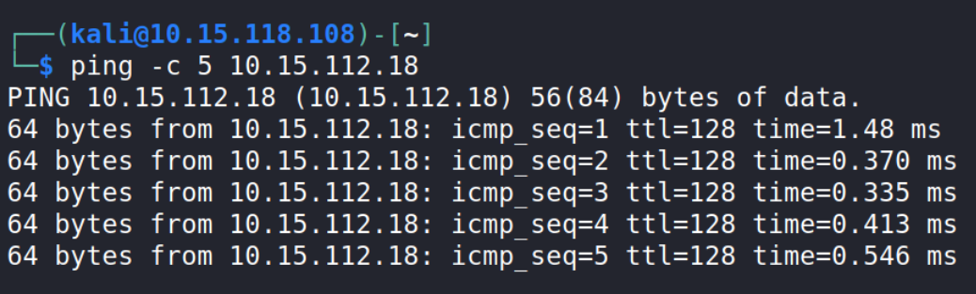
Seeing a Capture
Start capturing data in Wireshark
Open another Terminal
Ping an IP Address of another device
ping -c 5 <IP_Address>
Let the ping run the 5 times
Stop capturing data in Wireshark

Slide 13
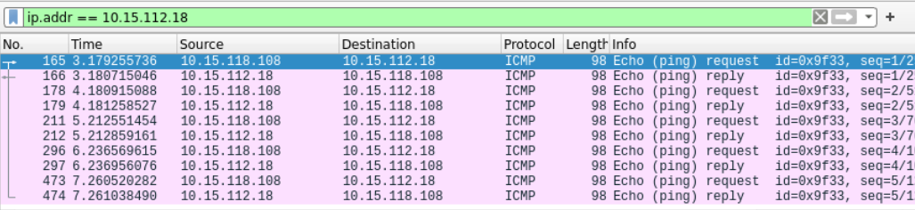
Seeing a Capture
In Wireshark, search for the following in the display filter up top
ip.addr == <IP Address>
Use the IP Address of device you pinged
Display filter search
Ping
Response

Slide 14
Questions to Ponder
Why is there so much back and forth between the two IP addresses?
Are there other packets being captured? If so, what do you think they're for?
Do different actions on the Windows 7 machine result in different packet captures via Wireshark?

